Slide 1

BroadVision
Template:
T&K Storyboard
DRAFT FOR DISCUSSION ONLY

Slide 2
Scenario Background

Slide 3




The Demonstrated Storylines for the T&K Customer Communities and the Users
      We have developed three scenarios to help show service capabilities for existing channels. These capabilities will differentiate between communities and function across a standard interface - the internet. Two of the scenarios are customer-facing between the T&K online store and one the two types of customer: a new, unregistered customer, and a registered customer. The third scenario follows a T&K employee through navigation of the BroadVision Command Center.
New Customer
Registered Customer
Command
Center
Employee

Slide 4
The Demonstrated Storylines for the
Three T&K Customer Communities
Scenario 1: New Customer Registers
  Entering site
  Registering as a user
  Accessing Account
  Completing Profile information
  Completing Address and Payment information
Scenario 2: Registered Customer makes a Purchase
  Logon to customized site/features
  Browsing site using search functionality
  Make a purchase
  Select address and payment information
  Order review and confirmation
Scenario 3: Swatch BroadVision User
  Create a new Sub-category
  Add new Products
  Delete Products
  Create new Community
  Create new Rules
Command
Center

Slide 5




Scenario 1:
New Customer Registers

Slide 6
Scenario 1-
T&K New Customer Registers
    This scenario describes the experience of
    a new customer registering on the site
Customer enters site
Customer decides to Register
Customer picks up coupon
Customer completes profile information
1
2
3
4
Josh is a new customer entering the T&K site for the first time.
Josh is interested in registering on the T&K site and decides to do so right away in order to receive his coupon
Josh picks up the coupon and attaches it to his wallet
Josh decides to complete the profile information in order to
Customer views personalisation differences
Customer selects My Account
Customer completes address book
Customer completes payment methods
5
6
7
8
Josh returns to the home page and realizes that the page has changed to suit his interests
Josh wants to further customize his shopping experience, and so he goes to My Account
Josh decides to fill out the address book in order to simplify his future shopping experiences
Josh fills out the payment method page
The following pages explore each of these elements of the storyboard in more depth.

Slide 7
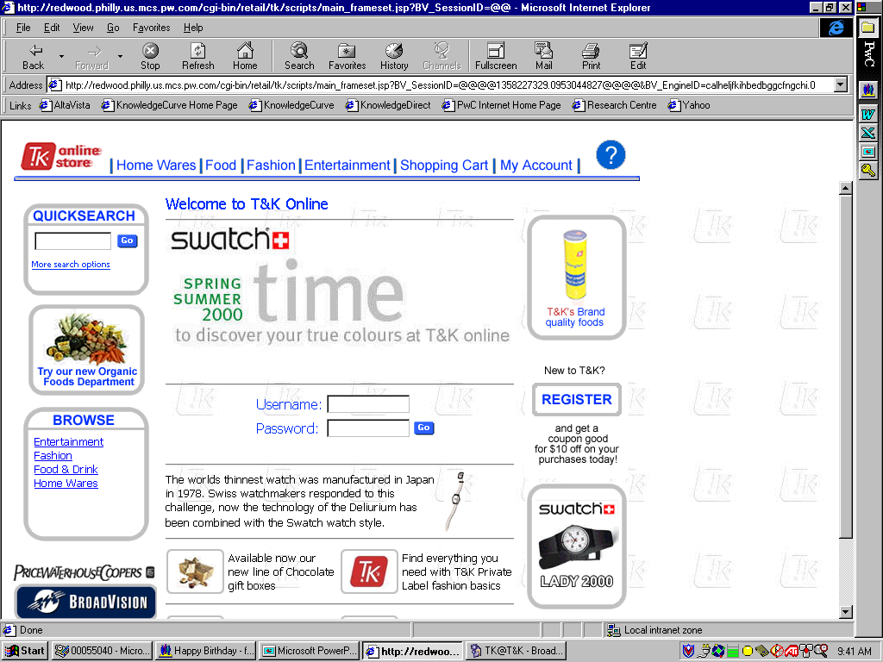
Scenario 1-
T&K New Customer Registers
1. New Customer enters the T&K site
Description of the customer experience:
    Josh is interested in shopping online
    He navigates to the T&K online store using his browser
    Josh is asked for login information and sees that he can register to become a T&K customer
Value to T&K’s new customers:
    Quicker, more interactive means of browsing, purchasing goods, and monitoring purchase history
Enabling applications/features of BroadVision:
    Guest visitor functionality allows unregistered user to browse site and begin shopping
    Default role action pushes content to unidentified user

Slide 8
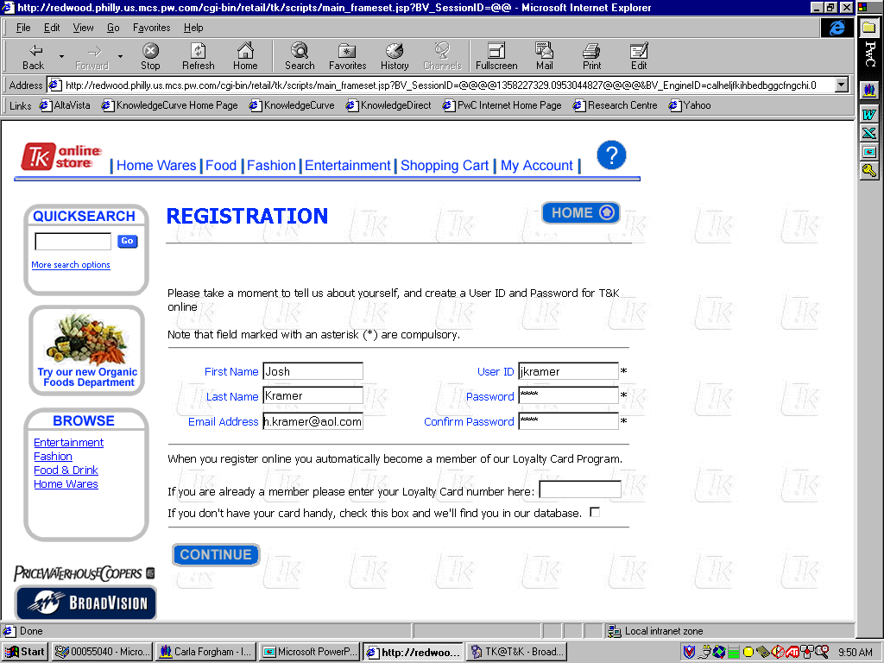
Scenario 1-
T&K New Customer Registers
2. Customer decides to Register
Description of the customer experience:
    Josh clicks the “Register” button on the homepage and is brought to the registration screen
    Customer enters his First Name, Last Name, Email Address, User Id, and Password
    Josh hits continue to complete his registration and sees that he has received his $10 coupon
    He is given the option to complete his profile or to begin shopping
Value to new customer:
    Customer is automatically a member of the loyalty card program
    Customer receives the offered incentive for registering
Enabling applications/features of BroadVision:
Create new user ID

Slide 9
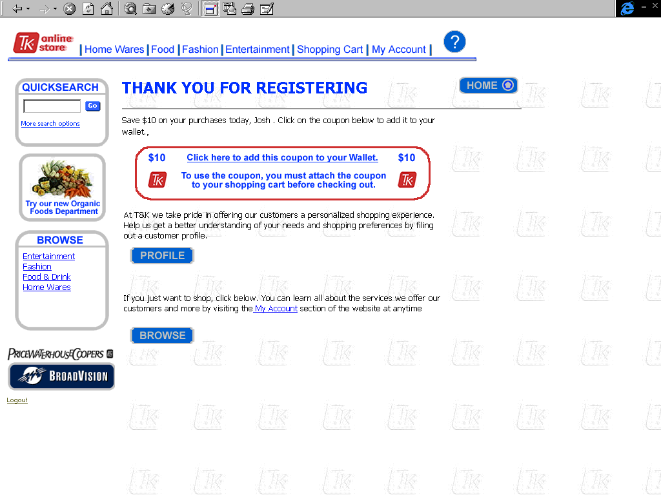
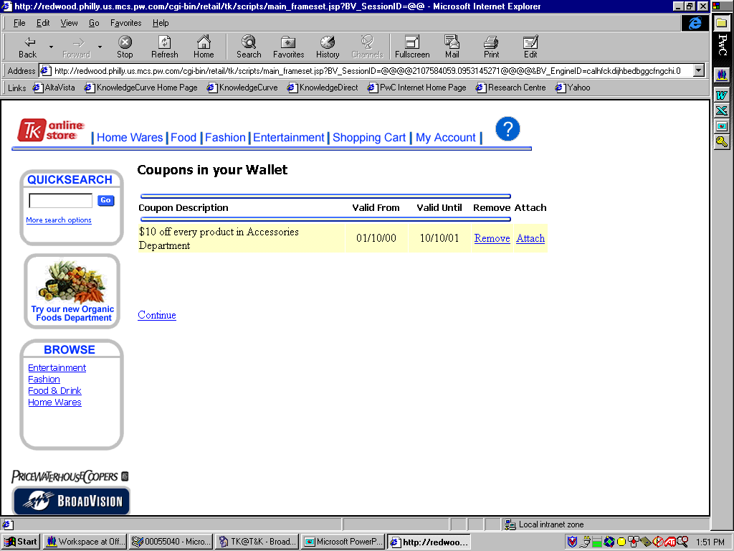
Scenario 1-
T&K New Customer Registers
3. Customer picks up Coupon
Description of the customer experience:
    Josh sees that he has received the $10 coupon offered for registering shopping
    He clicks on the coupon to and is brought to the Coupons in Your Wallet screen
    Josh clicks “Attach” to attach the coupon in his wallet, and then hits “Continue” to return to the “Thank you for Registering” screen
Value to new customer:
    Customer receives coupon to use on site
Enabling applications/features of BroadVision:
    Incentive is used to encourage registration which will allow for personalization

Slide 10
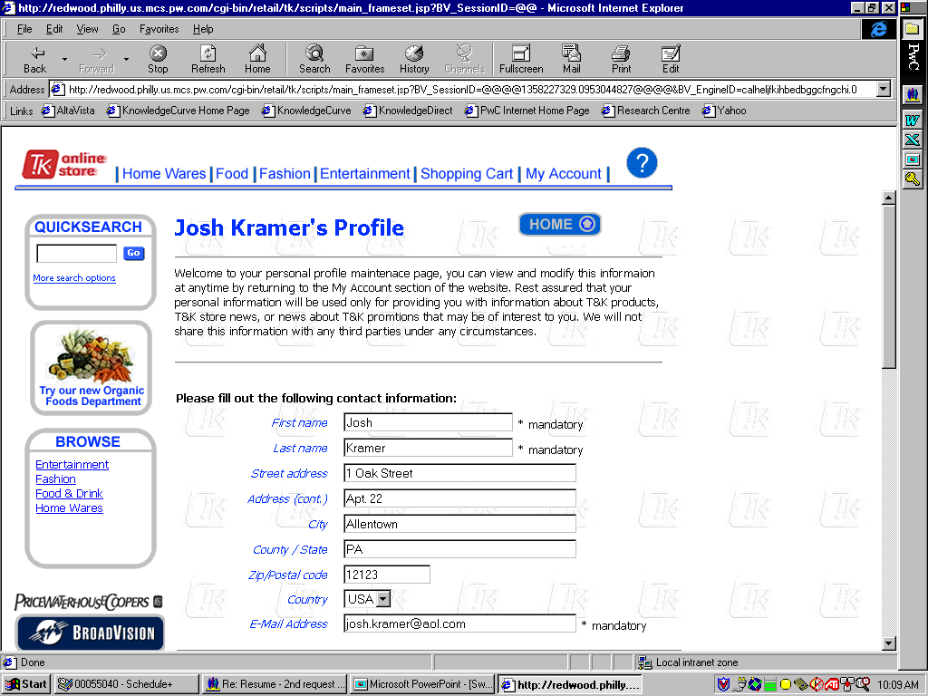
Scenario 1-
T&K New Customer Registers
4. Customer completes profile information
Description of the customer experience:
    Josh decides to click the “Profile” button and is brought to the Profile screen
    His name and email address are already filled out
    Josh completes information for Address, Gender, Income, Incentive Preferences, Shopping Interests, Contact Preferences, and the option to change Password
Value to new customer:
    Tailors product-ordering session to meet his personal interest needs
    Creates default shipping addres
Enabling applications/features of BroadVision:
Explicit questionnaire used to create initial profile which is the basis for all BroadVision personalization

Slide 11
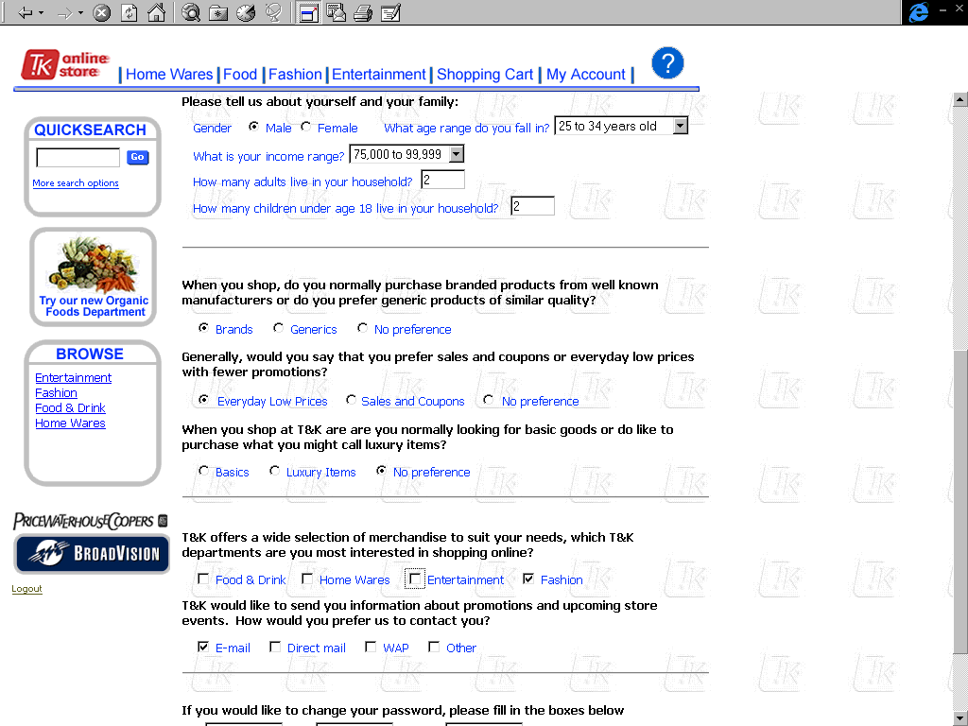
Scenario 1-
T&K New Customer Registers
4. Customer completes profile information(Cont’d)

Slide 12
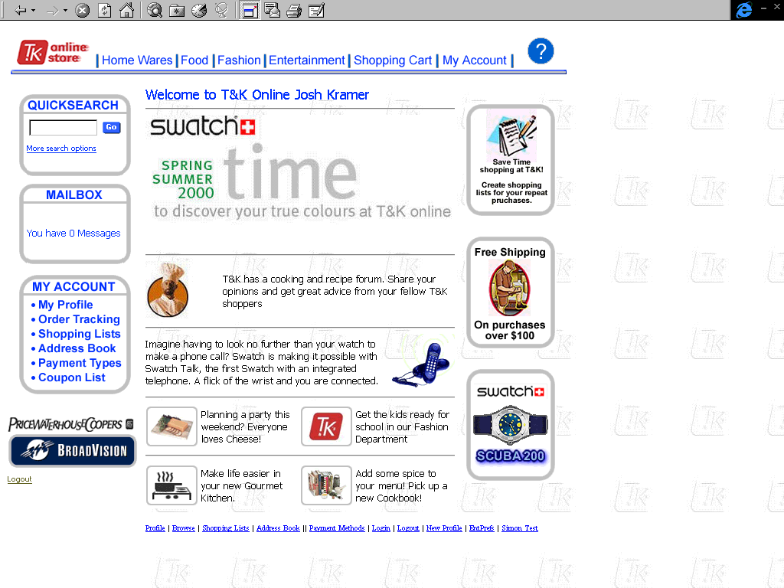
Scenario 1-
T&K New Customer Registers
5. Customer views personalization on homepage
Description of the customer experience:
    Josh returns to homepage and sees an editorial for Easier Life in a Gourmet Kitchen, and an ad for Saving Time on T&K, both tailored to his profile of a time-starved professional
    Josh sees the Free Shipping ad displayed, which replaces the Registration request
Value to new customer:
    The customer views personalization which makes the shopping experience unique and convenient
    Customer is targeted as a user with high spending power and a candidate for free shipping
Enabling applications/features of BroadVision:
    Personalized content based on profile
    Use of editorial & advertisement based rule sets to deliver content
    BroadVision alert messages displayed in mailbox
    Link to shopping list functionality
    Links to category navigation

Slide 13
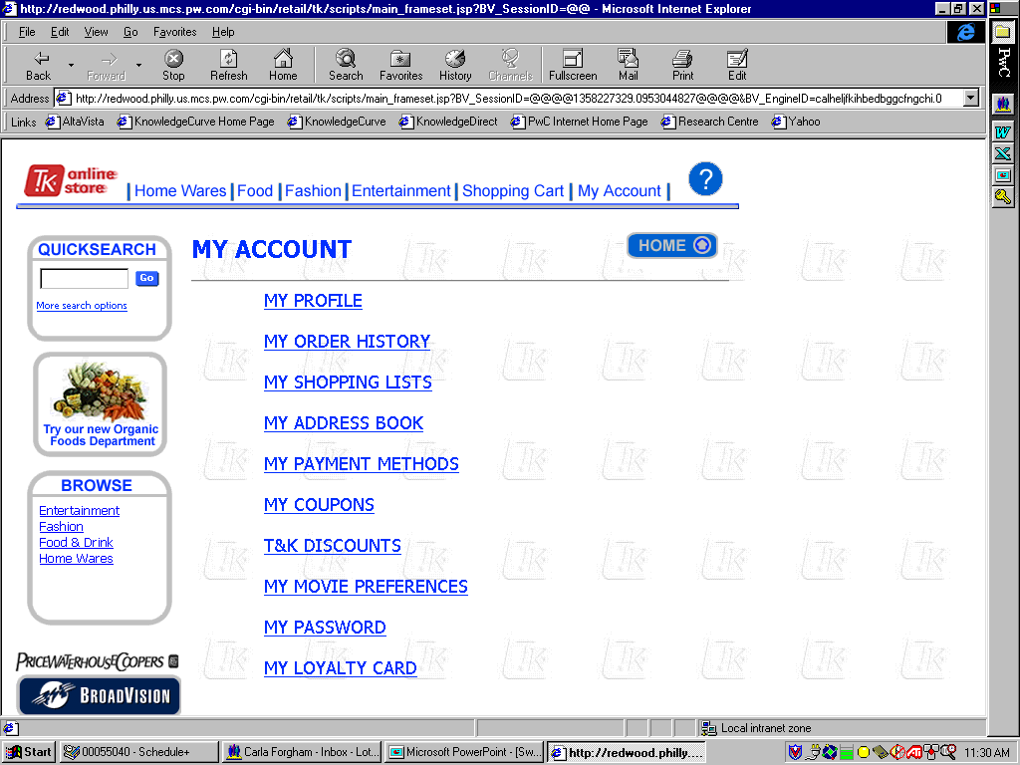
Scenario 1-
T&K New Customer Registers
6. Customer completes address information in account
Description of the customer experience:
    Josh is pleased with the newly personalized homepage, so he clicks “My Account” in order to further customize his settings
    He is brought to the My Account page, where he is offered the option to change his Profile, Address book, Payment Methods, Movie Preferences, and Password; and, he can view his Order History, Shopping list, Coupons, Discounts, and Loyalty Card
Value to new customer:
    The customer can update his account to maintain preferences and profile
    Customer has ability to track account information
Enabling applications/features of BroadVision:
    Profile
    Order Tracking
    Stored address & Payment methods
    Coupons & Discounts
    Shopping lists
    Taxonomy matching preferences

Slide 14
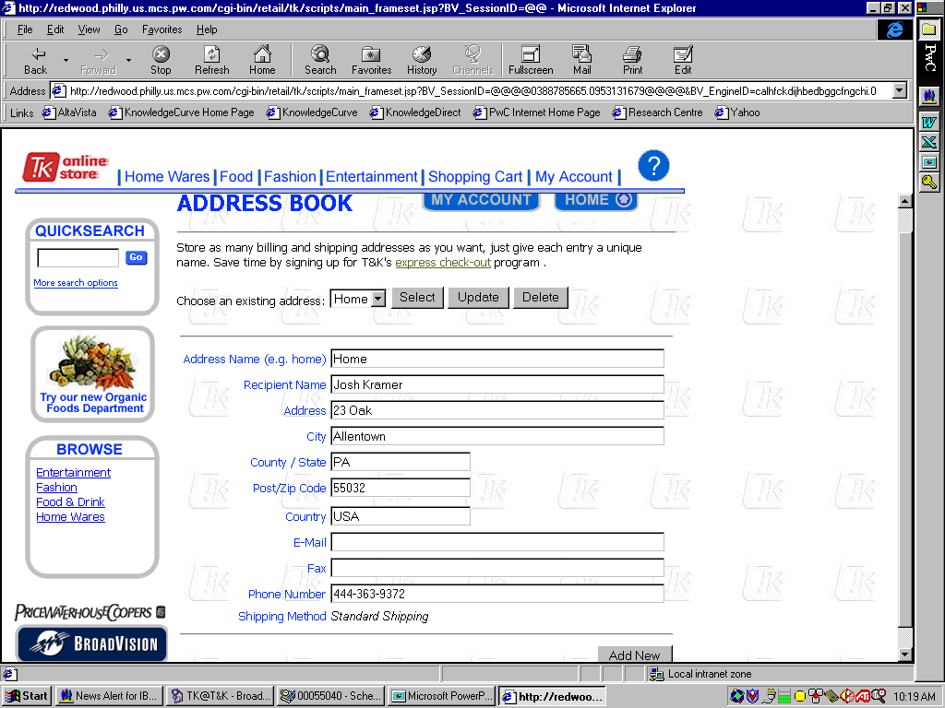
Scenario 1-
T&K New Customer Registers
7. Customer completes address information
Description of the customer experience:
    Josh clicks My Address Book and is brought to the Address Book screen
    He completes the shipping address information for his Home, which also includes Phone, Fax, and Email
    Josh clicks Add New to save and return to the My Account screen
Value to new customer:
    The customer can specify multiple addresses for future selection during a purchase
Enabling applications/features of BroadVision:
    Address book

Slide 15
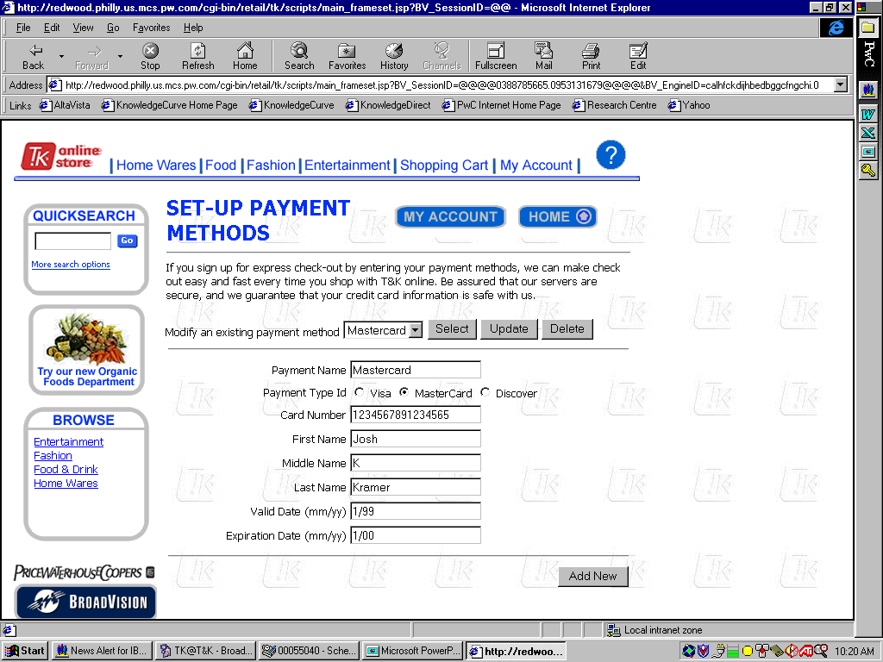
Scenario 1-
T&K New Customer Registers
8. Customer completes payment information
Description of the customer experience:
    From the My Account page, Josh clicks My Payment Methods and is brought to the Set-Up Payment Methods Screen
    He completes information for Payment Name, Payment Type Id, Card Number, Name, Valid Date, Expiration Date, and default preference
    Josh hits Add New to save the information and return to the Account Screen
Value to new customer:
    The customer can keep payment method information on file in order to make future purchasing faster and more convenient
Enabling applications/features of BroadVision:
    BroadVision wallet

Slide 16
Scenario 2:
Registered Customer

Slide 17
Scenario 2-
T&K Registered Customer
    This scenario describes the experience of a Registered Customer
Customer
Login
Customer Views Personalization
Customer Browses Categories
Customer uses search feature
Customer views product for purchase
1
2
3
4
5
Josh returns to the T&K shopping site to make a purchase, and logs in as a registered user
Josh sees that the site has changed to fit his interests and shopping needs
Josh is interested in purchasing a watch, and he the fashion and watches categories
Josh does not see the watch he wants, and so he uses the search options to narrow his search criteria
Josh selects a product from the search list and view it in greater detail
Customer views product in shopping cart
Customer selects address information
Customer selects payment information
Customer view Order Review
Customer receives order confirmation
6
7
8
9
10
Josh selects the product and is taken to the shopping cart in order to make a purchase
Josh chooses the shipping address from the addresses stored in his account
Josh chooses the payment information from the payment methods stored in his account
Josh is presented with a summary of the order, his shipping address and payment information
Josh receives an order number and confirmation of his purchase
The following pages explore each of these elements of the storyboard in more depth.

Slide 18
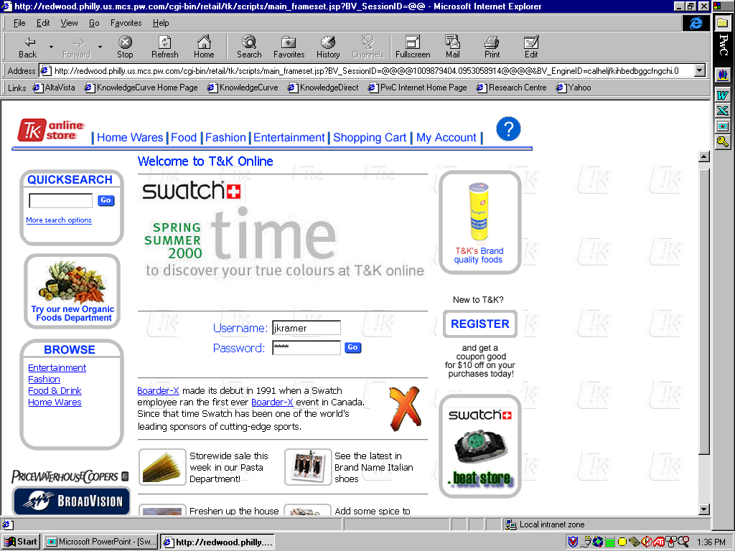
Scenario 2-
T&K Registered Customer
1. Customer Logs into Site
Description of the customer experience:
    Customer wants to place an order for a product
    Customer navigates to the T&K Online Shopping site using his internet browser
    The customer is asked to provide customer ID and password information to identify him to the system
Value to Registered Customer:
    Quicker, more interactive means of placing orders, reviewing account features, and monitoring purchase history
    Tailored Advertisements and Editorials
Enabling applications/features of BroadVision:
    Visitor component is used to perform authentication upon customer login
    Session component is used to identify existing user information and apply it to the session throughout the customer’s visit
    Matching agent delivers personalized content

Slide 19
Scenario 2-
T&K Registered Customer
2. Customer Views Personalized Screen
Description of the customer experience:
    Josh views changes to the homepage and sees an editorial for Easier Life in a Gourmet Kitchen, and an ad for Saving Time on T&K, both tailored to his profile of a
    Josh sees the Free Shipping ad displayed, which replaces the Registration request
Value to Registered Customer:
    The customer views personalization which makes the shopping experience unique and convenient
    Customer is targeted as a user with high spending power and a candidate for free shipping
Enabling applications/features of BroadVision:
    Command Center empowers business manager to create business rules which in turn dynamically alter content used to personalize promotional experience
    Command Center allows for ease in change of business rules by business managers without programming

Slide 20
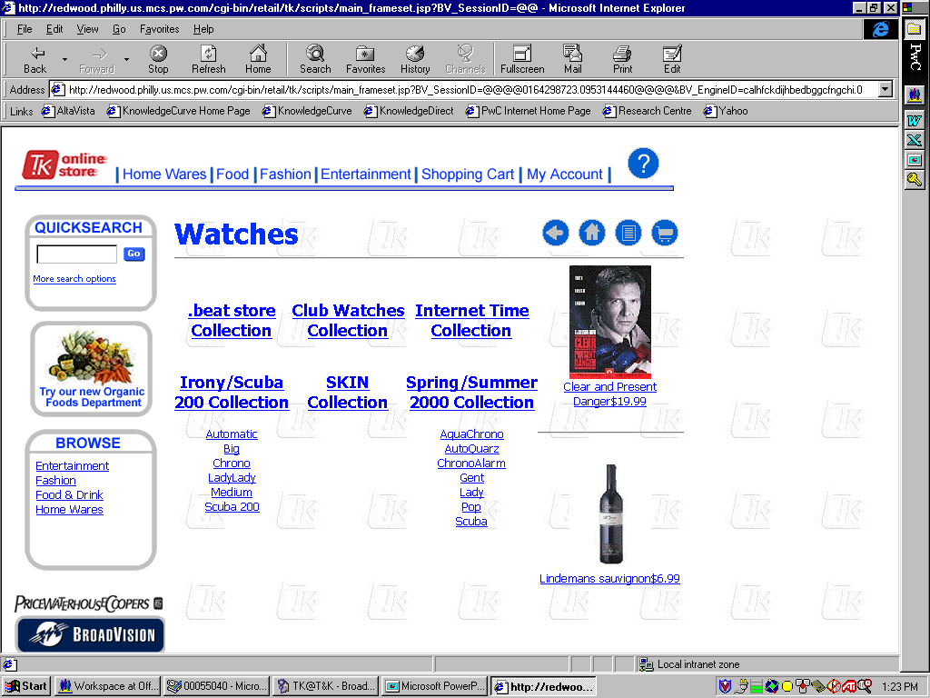
Scenario 2-
T&K Registered Customer
3. Customer browses Categories
Description of the customer experience:
    Josh clicks on the Fashion category, to see if he is interested in purchasing something there
    Josh sees the Watches sub-category and realizes that he needs a watch. He clicks on the sub-category and is brought to another category page
    Josh clicks on another category, but does not see the watch he wants. He decides to use the search functionality.
Value to Registered Customer:
    The customer has the ability to browse in categories that they are interested in
Enabling applications/features of BroadVision:
Dynamic page generation based on merchandise hierarchy defined in command center

Slide 21
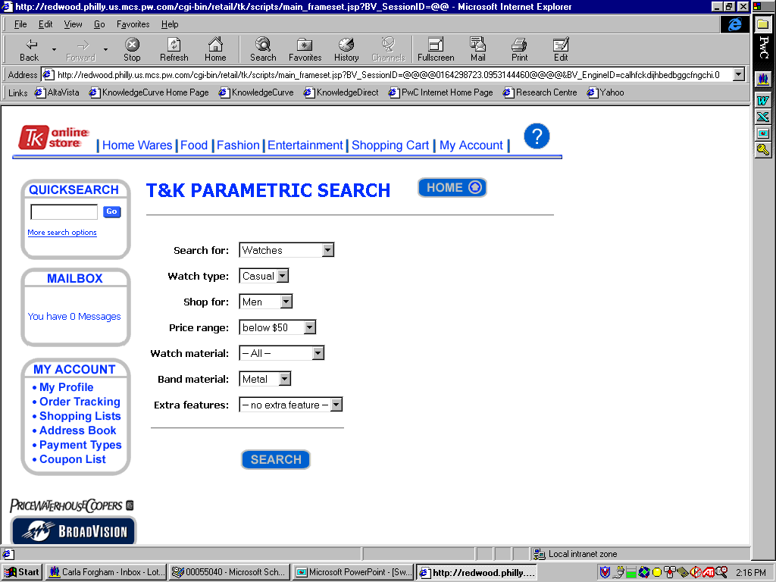
Scenario 2-
T&K Registered Customer
4. Customer Uses Search Feature
Description of the customer experience:
    Josh clicks the More Search Options link for QuickSearch in order to specify what he is looking for.
    Josh completes information for Search By, Watch Type, Shop For, Price Range, Watch Material, Band Material, and Extra Features
    Josh clicks “Find it!” to begin the search
Value to Registered Customer:
    The customer has the ability to perform searches with specific criteria
Enabling applications/features of BroadVision:
Parametric searching of product catelog

Slide 22
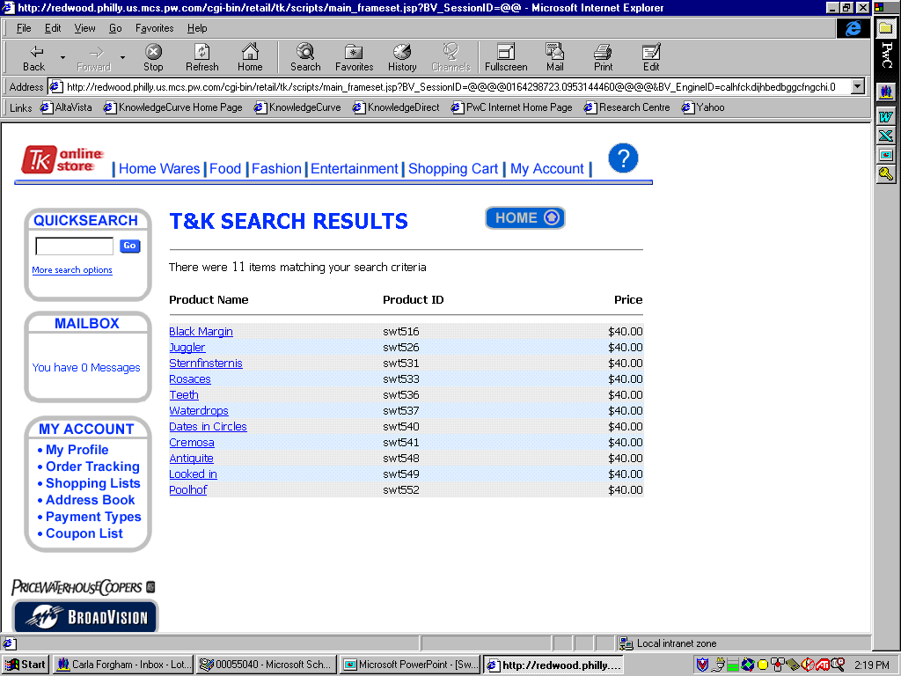
Scenario 2-
T&K Registered Customer
4. Customer Uses Search Feature, cont.
Description of the customer experience:
    Josh is presented with a list of watches on the Search Results screen
    By clicking on the name of the product, Josh can view the product in greater detail
Value to Registered Customer:
    The customer has narrowed their search and can now view a number of products that fit their purpose
Enabling applications/features of BroadVision:
Parametric searching of product catelog

Slide 23
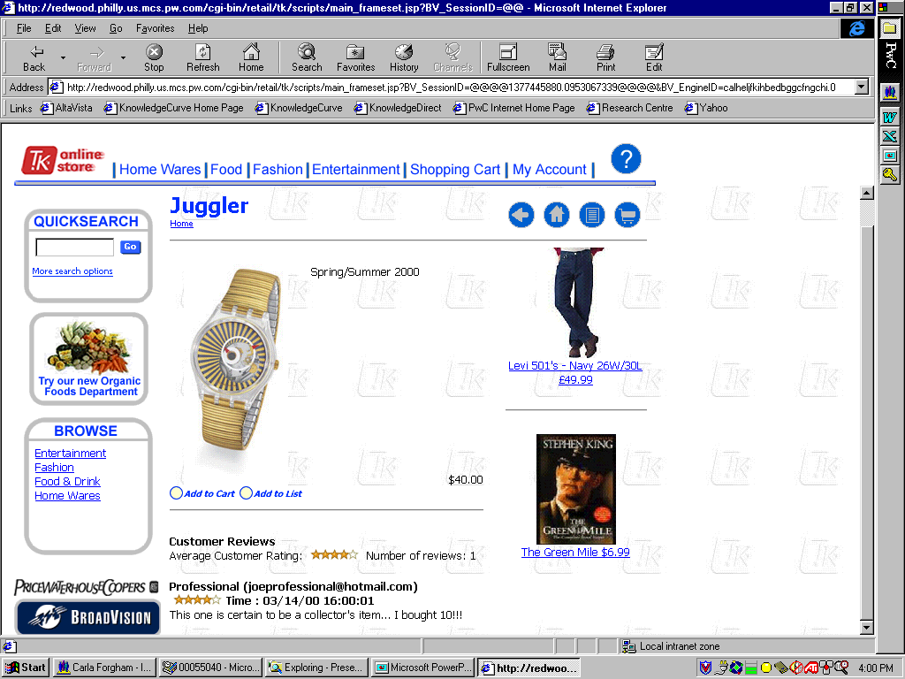
Scenario 2-
T&K Registered Customer
5. Customer Views Product for Purchase
Description of the customer experience:
    Josh views the product he is interested in purchasing
    Josh sees the two ads with have been tailored to his profile
    He can read a review of the watch by another user
    Josh clicks on the Add to Cart icon to add the item to his Shopping cart, and he is brought to the Shopping Cart screen
Value to Registered Customer:
    The customer views personalization which makes the shopping experience unique
    Customer has access to user opinions of the product
    Customer can make a purchase immediately
Enabling applications/features of BroadVision:
    Command Center empowers business manager to create business rules which in turn dynamically alter content used to personalize promotional experience
    Customer reviews

Slide 24
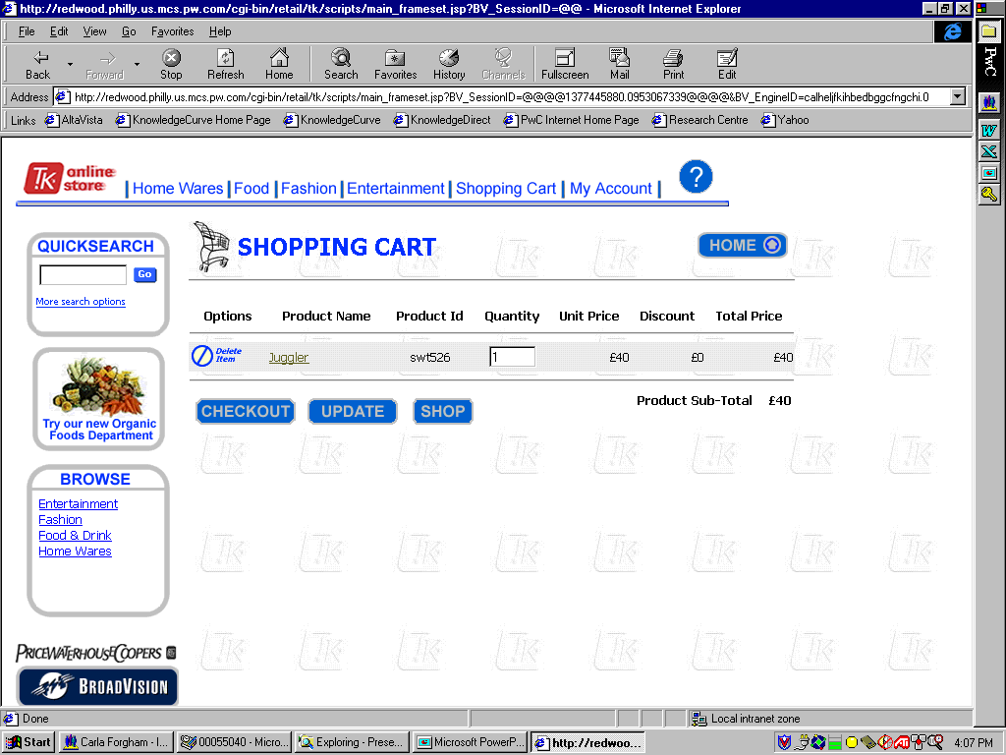
Scenario 2-
T&K Registered Customer
6. Customer Views Product in Shopping Cart
Description of the customer experience:
    Josh is brought to the Shopping Cart page where he can view the item he selected
    Josh has the option to delete the item by clicking the Delete Item button
    Josh has the option to change the quantity
    Josh selects the Checkout button in order to purchase the item in his shopping cart
Value to Registered Customer:
    Customer can review the item and make changes before making the final purchase
Enabling applications/features of BroadVision:
    BroadVision One to One Commerce Shopping Cart

Slide 25
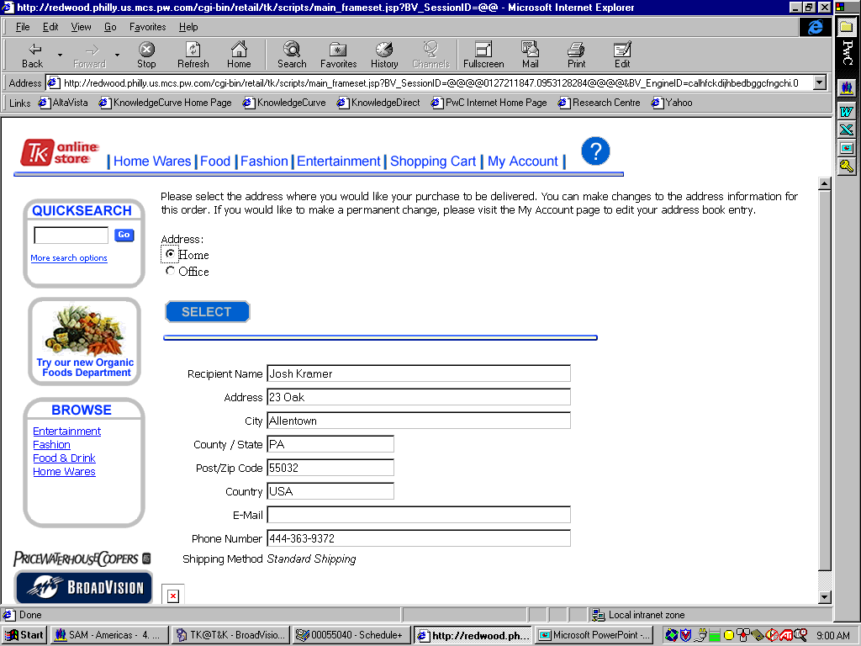
Scenario 2-
T&K Registered Customer
7. Customer Selects Address information
Description of the customer experience:
    Josh is brought to the address selection screen
    Josh has the option to select one of the address in his account Address Book
    He clicks the Select button to populate the address fields with the address of his choice
    Josh then clicks the Continue button to proceed with his purchase
Value to Registered Customer :
    The customer can quickly submit a shipping address by using one of the addresses already stored in his account
Enabling applications/features of BroadVision:
    Stored address information

Slide 26
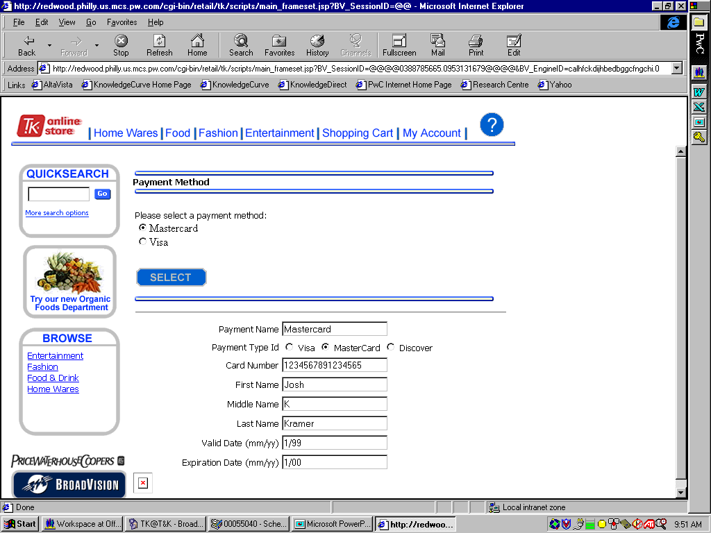
Scenario 2-
T&K Registered Customer
8. Customer Selects Payment method
Description of the customer experience:
    Josh is brought to the Payment Method screen
    Josh has the option to select one of the payment methods stored in his account
    He clicks the Select button to populate the payment fields with the payment method of his choice
    Josh then clicks the Continue button to proceed with his purchase
Value to Registered Customer:
    The customer can quickly submit a payment method by using one of the payment methods already stored in his account
Enabling applications/features of BroadVision:
    Store payment information in Customer Wallet

Slide 27
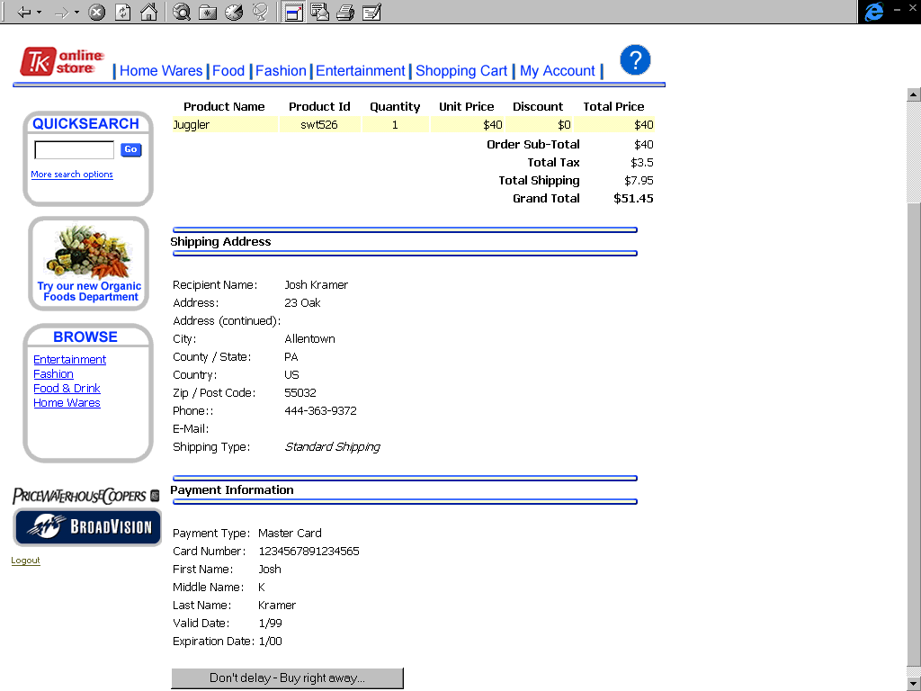
Scenario 2-
T&K Registered Customer
9. Customer views Order Review
Description of the customer experience:
    Josh is brought to the Order Review screen
    Josh views his Order Summary, Shipping Address, and Payment Information
    In order to complete the purchase, Josh clicks the “Don’t Delay, Buy Right Away” button
Value to Registered Customer:
    The customer can view all of the transaction information on one screen and can then determine if he wishes to complete the order
Enabling applications/features of BroadVision:
    Order review process

Slide 28
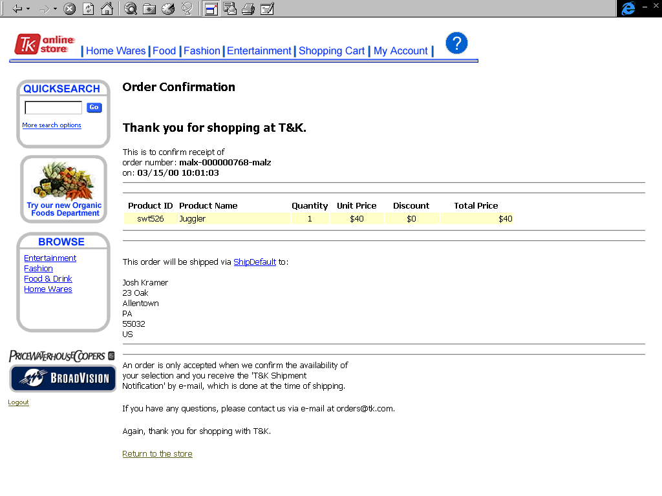
Scenario 2-
T&K Registered Customer
10. Customer views Order Confirmation
Description of the customer experience:
    Josh is brought to the Order Confirmation screen
    Josh receives an order number and is given an email address which he can use if he has any questions regarding the transaction
    Josh now has the option to continue shopping by clicking the “return to store” link
Value to Registered Customer:
    The customer is assured that the order has been received when he is given an order number
    The customer is notified that the order may not be accepted if the product is not available
Enabling applications/features of BroadVision:
    Sales rep creates BroadVision Order number & completes the purchasing process
    Order available for tracking

Slide 29
Scenario 3:
T&K BroadVision User

Slide 30
Scenario 3-
T&K BroadVision User
Command
Center
    This scenario describes the experience of a swatch employee who is a BroadVision user
User
Login
User Creates new Sub-category
User adds new products to the product list
User Deletes unwanted Product
1
2
3
4
T&K’s User enters the command center and logs in to the TK service
The User creates a new Sub-category as part of the Spring/Summer 2000 collection of watches
The User adds three products to the new sub category he created
The User wants to Delete a cancelled watch style
User creates new community
User creates a new rule
5
6
The User creates a new community which includes females age 25 years and older
The following pages explore each of these elements of the storyboard in more depth.

Slide 31
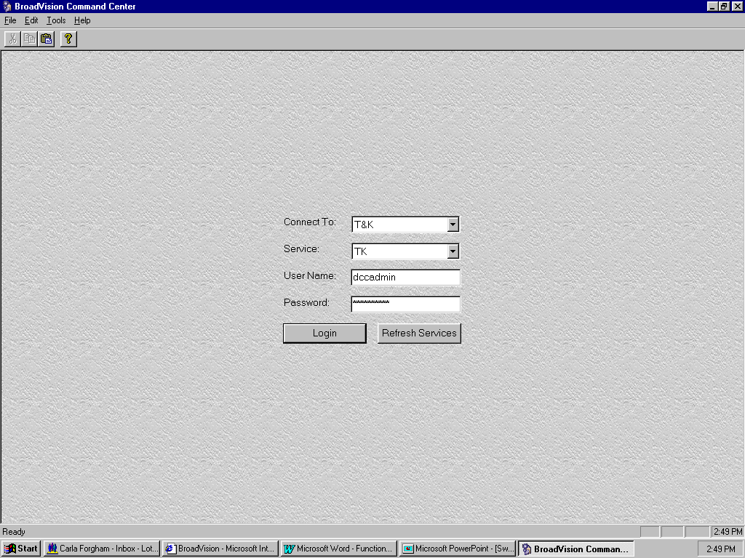
Scenario 3-
T&K BroadVision User
1. User Logs into Command Center
Description of the user experience:
    User wants to add new products to the web site
    User Opens the Command Center
    The user enters the connection, service, user name, and password, and then clicks “login”
Value to Swatch BroadVision User:
    Quicker, more interactive means of placing orders, reviewing contract features, and monitoring purchase history
Enabling applications/features of BroadVision:
    Command Center login is used to perform authentication upon user login

Slide 32
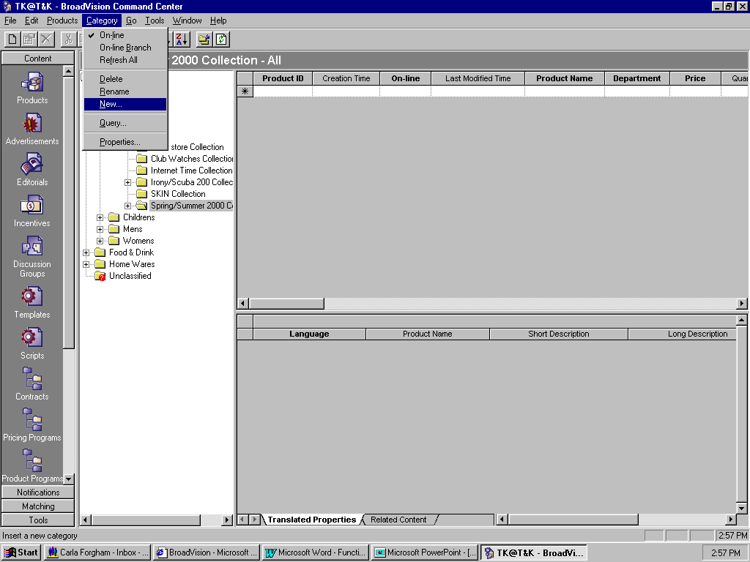
Scenario 3-
T&K BroadVision User
2. User creates new sub-category under Spring/Summer 2000 Collection
Description of the user experience:
    User clicks the Products icon under Content
    User expands Fashion, Accessories, and Watches, and then highlights the sub-category “Spring/Summer 2000 Collection”.
    User drops down the Category menu and selects “New”. He enters “AquaChrono” into the name field and clicks OK.
Value to Swatch BroadVision User:
    Simple method of branching the databases
    Data is easy to organize and categorize
Enabling applications/features of BroadVision:
    Command center allows product content types to be organized using merchandise categories
    Merchandise hierarchy is flexible & can be modified at any level
    Products can be added at any level of the hierarchy

Slide 33
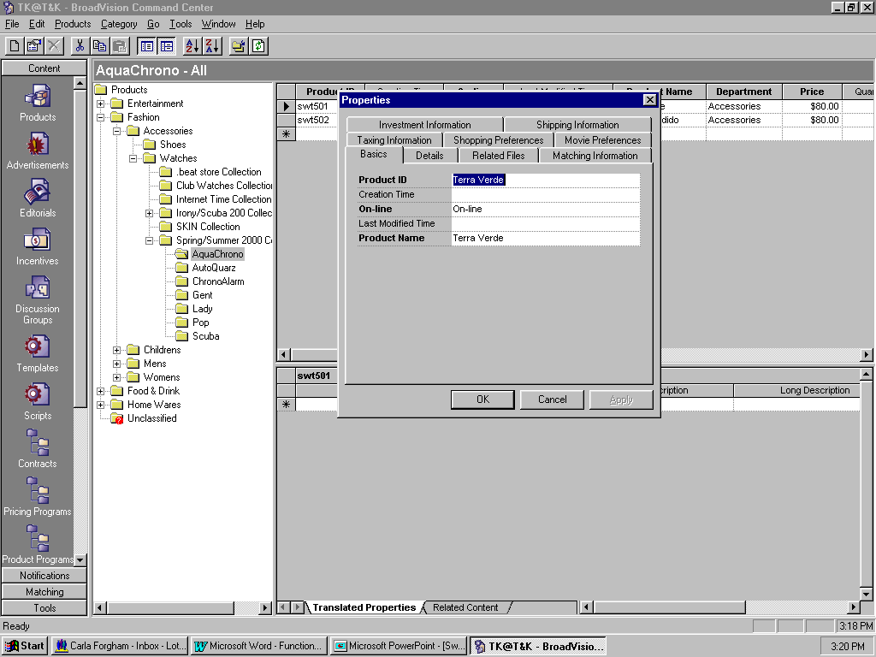
Scenario 3-
T&K BroadVision User
3. User adds product to new subcategory
Description of the user experience:
User highlights the sub-category, “AquaChrono”.
He drops down the Products menu and selects “New” to open the new products properties box.
On the “Basics” tab, he enters the data for required fields: Product Id, On-line, and Product Name.
On the “Details” tab, he enters the data for required fields Department, and Price.
The User clicks OK, and then repeats the steps for additional products.
Value to Swatch BroadVision User:
    Flexible method of adding styles to products list
Enabling applications/features of BroadVision:
    Command center allows direct entry of new product information, which can be made available on-line immediately

Slide 34
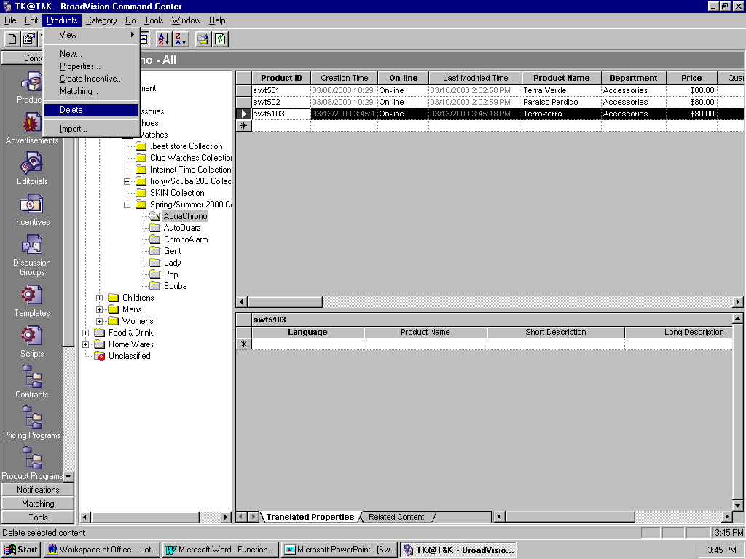
Scenario 3-
T&K BroadVision User
4. User deletes old product from sub-category
Description of the user experience:
    User highlights unwanted product by clicking on the row’s left margin
    User drops down the Product menu and selects “Delete”.
Value to Swatch BroadVision User :
    Delivers information
    pertaining to him without
    his having to search for it
    Opportunity to present personalized marketing
Enabling applications/features of BroadVision:
    Products are easily removed from the web-site using the command center. Products can be removed temporarily or permanently

Slide 35
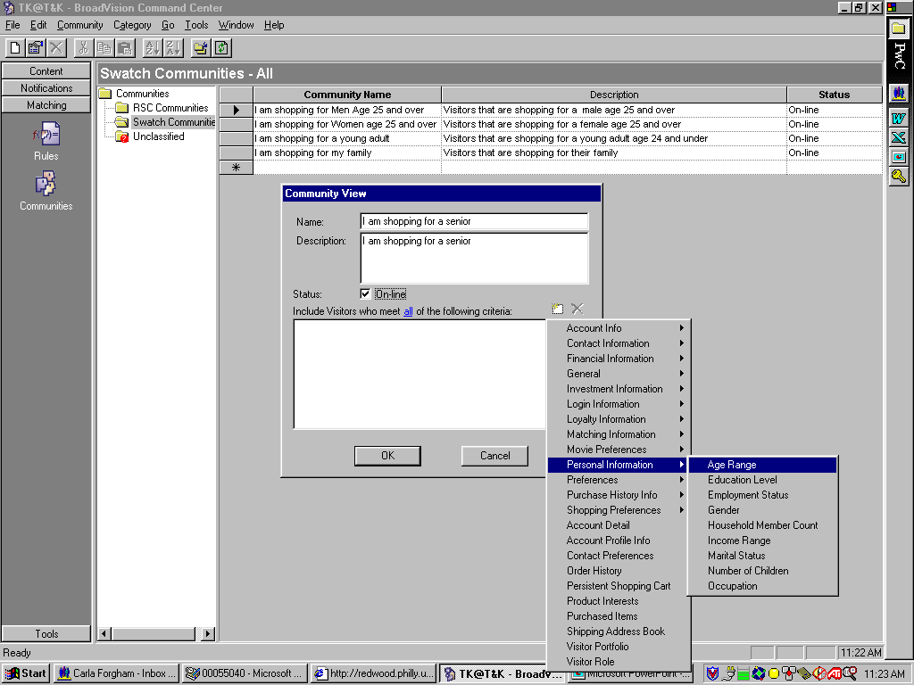
Scenario 3-
T&K BroadVision User
5. User creates new customer community
Description of the user experience:
User clicks the Communities icon under Matching
User expands the communities folder and highlights the desired community category
Drop down the Communities menu, and select “New”
Enter a Community Name, Description, and check off “On-line”
Click on the “Create a new Criterion” icon, and select “Personal Information” --> “Age Range”
Value to Swatch BroadVision User:
    Flexible method of organizing groups
Enabling applications/features of BroadVision:
    Customer segmentation using the BroadVision user profile & community definition manages the amount of content required and defines a standard set of customized sites that can be further tailored to the individual

Slide 36
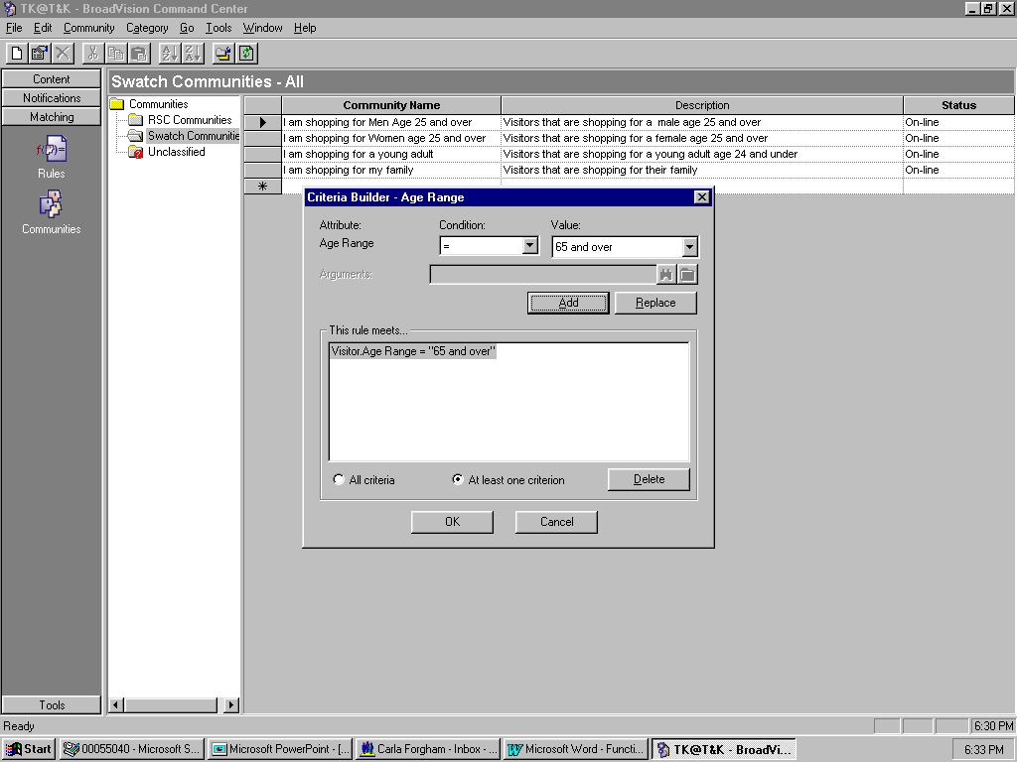
Scenario 3-
T&K BroadVision User
5. User creates new customer community cont.
Description of the user experience:
User selects the Condition “=“
User selects the Value “65 and older”
The User clicks the Add button in order to add the attribute to the criteria list
Click the OK button on the Criteria Builder and then click the OK button on the Community View
Value to Swatch BroadVision User:
Enabling applications/features of BroadVision:
    Communities are the basis for definition of matching rule targets

Slide 37
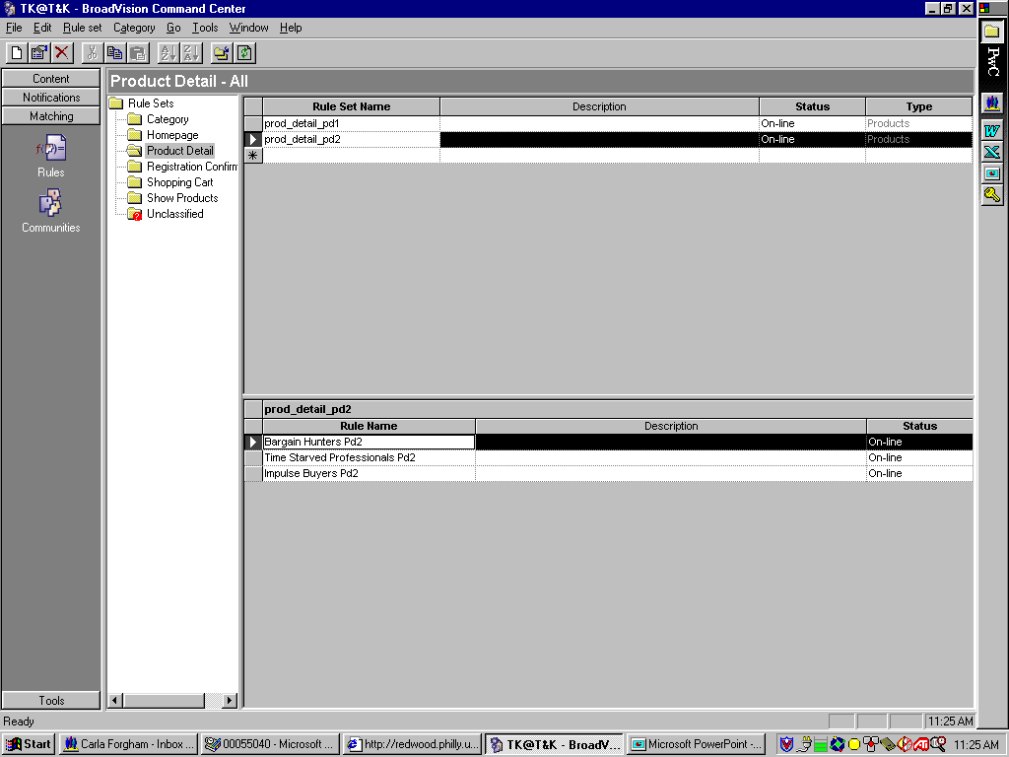
Scenario 3-
T&K BroadVision User
6. User Creates New Rule
Description of the user experience:
While still in matching, the user clicks the Rules icon
The user highlights the Product Detail folder to display the product detail rule set names
The drops down the Rule Set menu, and selects New
Value to Swatch BroadVision User:
    User can easily make changes and add new rules using the command center
Enabling applications/features of BroadVision:
    Matching rules control all personalized content on the user interface
    Rules can be used to deliver Products/Ads/Editorials and Incentives to the web-site

Slide 38
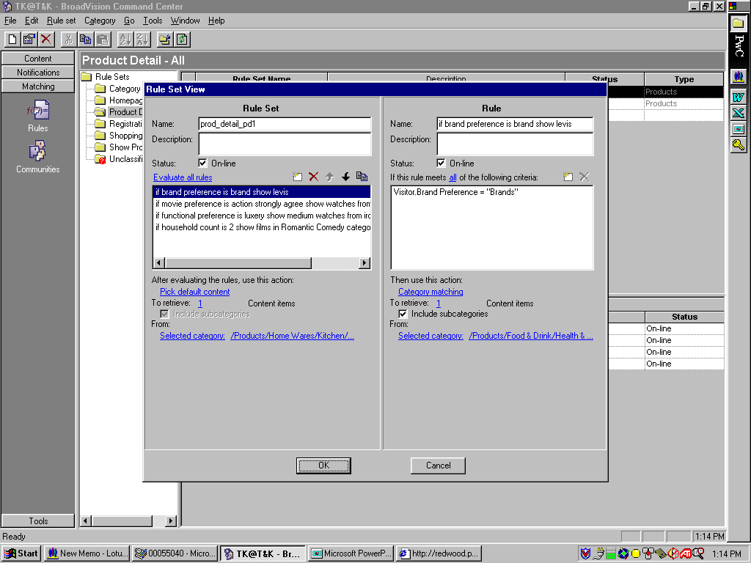
Scenario 3-
T&K BroadVision User
6. User Creates New Rule, cont.
Description of the user experience:
The user determines whether the rule set applies to all visitors or to certain visitors
The user can create multiple rules for each rule set
The user establishes which criteria to include in each rule
As a safeguard, the user can specify default content to be displayed when no rules are met
Value to Swatch BroadVision User:
    Command center rule wizard guides the user through the steps necessary to create rules and rule sets
    Rule set view allow easy, quick changes to rules
Enabling applications/features of BroadVision:
    Matching technologies include category matching, taxonomy matching , query based matching & session based rules

